Slide 1


제주공항 지연과
제주 안전지대 현황 분석

Slide 2
CONTENTS
1.
팀원소개
2.
1차 프로젝트
슬기로운 비행생활
03
2차 프로젝트
제주도 안전지대 현황 분석
04
한계점

Slide 3
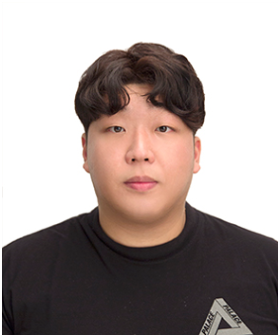
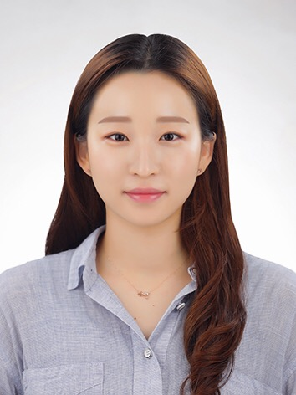
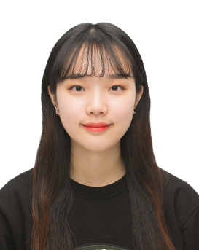
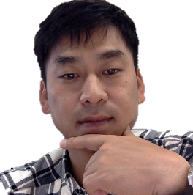
01.팀원 소개
사랑하는 멘토님
Richard.Ko
Teddy
1차, 2차 PL
데이터 분석
시각화
보고서 작성
Daniella
- 주간 보고서 작성
- 데이터 수집
데이터 분석
시각화
Vanessa
3차 PL
데이터 분석
시각화
보고서 작성

Slide 4

1
슬기로운 비행생활
분석 주제
차 프로젝트
분석 및 가설 검증
데이터 수집
현황 분석

Slide 5

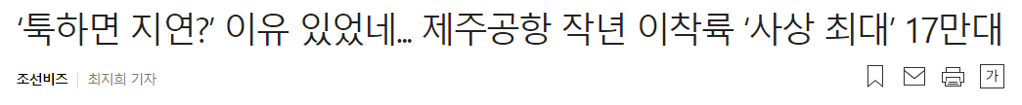
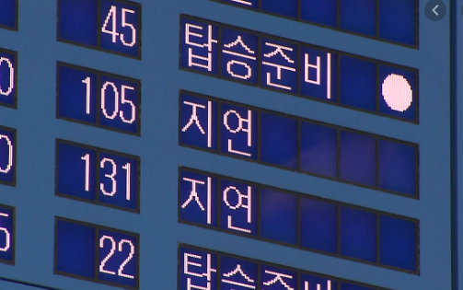

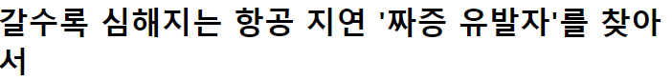


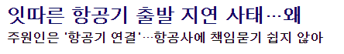

01. 분석주제

Slide 6
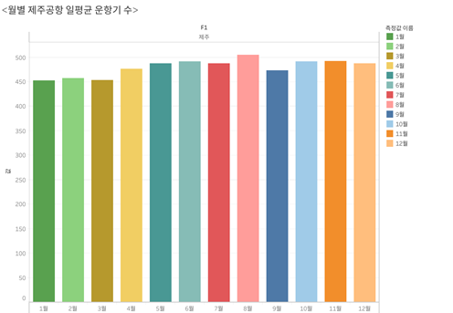
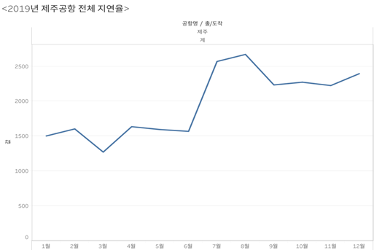
02. 분석 및 가설 검증
가설 1 : 제주공항 비행기가 많을수록 지연이 많을 것이다.

Slide 7
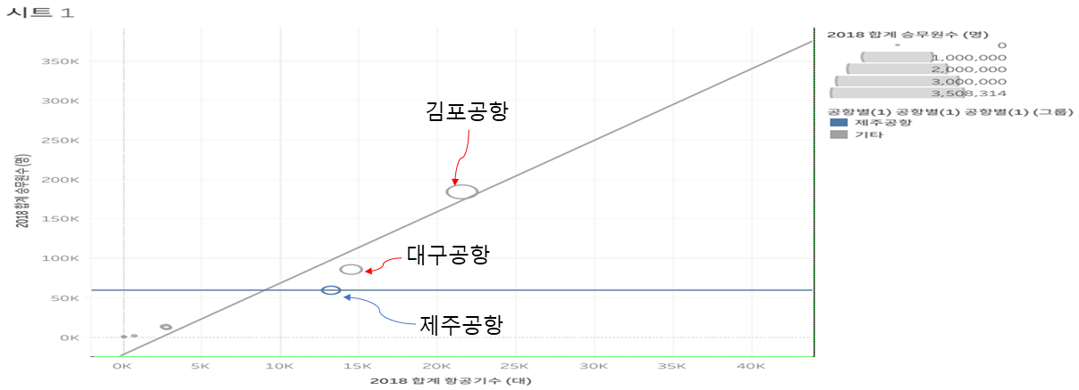
02. 분석 및 가설 검증
가설 2 : 제주 공항의 근로자 수가 부족해서 지연이 높을 것이다..

Slide 8
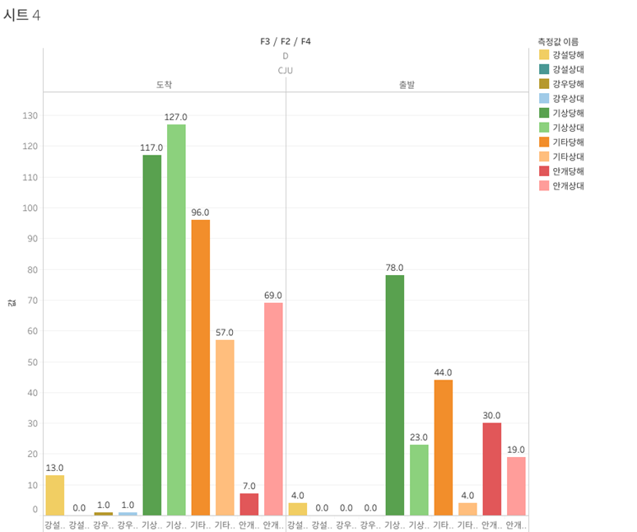
02. 분석 및 가설 검증
가설 3. 제주공항 날씨에 의한 지연이 많을 것이다.
35972번 중 633번(1.8%)

Slide 9
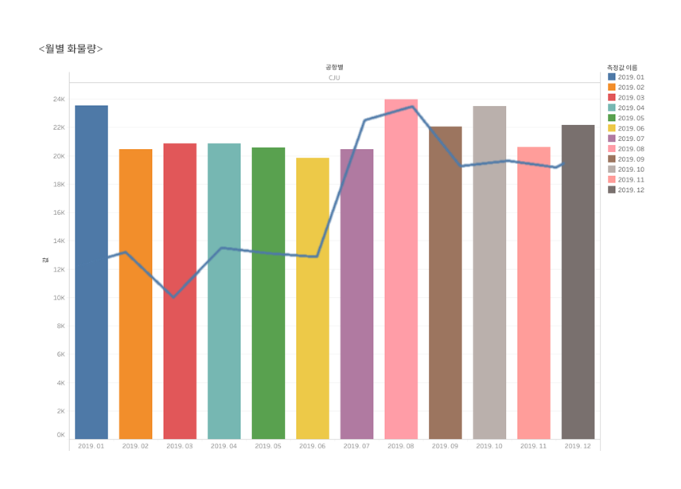
02. 분석 및 가설 검증
가설 4. 화물이 많을 때 지연이 많을 것이다.

Slide 10



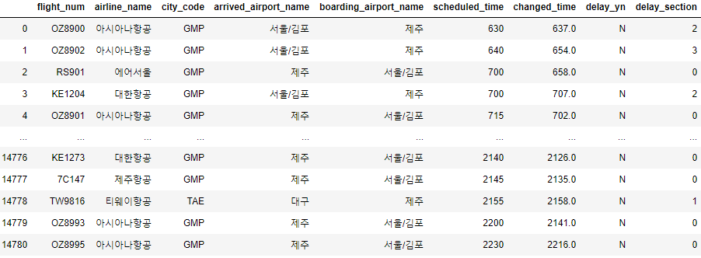




03. 데이터 수집
Flight_num : 4.27~6.8일까지 운행된 항공편명
Airline_name : 7가지 항공사
Arrived_airport_name : 출발지
Boarding_airport_name : 도착지
Scheduled_time : 예정도착시간
Changed_time : 실제도착시간
Delay_section : (임의로 구한) 도착 지연 여부
(6가지로 구분)

Slide 11
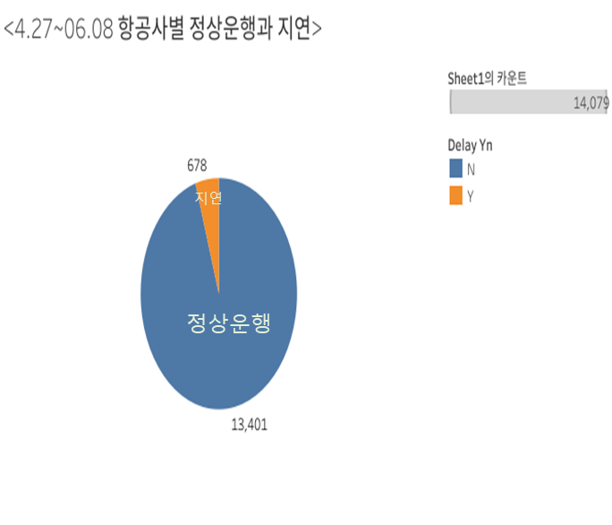
04. 현황 분석
4.27 ~ 06.08 항공사별 정상운행과 지연

Slide 12
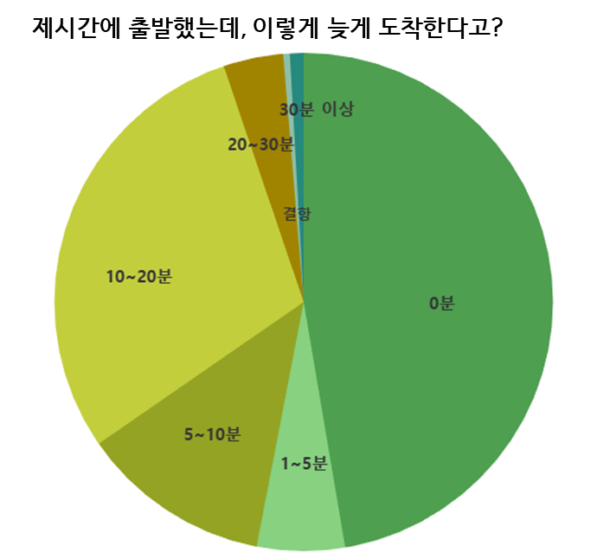
04. 현황 분석
제시간에 출발했는데, 이렇게 늦게 도착한다고?
10~20분 늦게 도착했을 때
4
1
제시간에 도착했을 때
29.4% (3944건
47.3% (6343건)
20~30분 늦게 도착했을 때
5
1~5분 늦게 도착했을 때
3.9% (521건)
2
5.7% (763건)
30분 이상 늦게 도착했을 때
6
0.9% (119건)
3
5~10분 늦게 도착했을 때
12.3% (1654건)
결항되었을 때
7
42%
0.4% (57건)

Slide 13
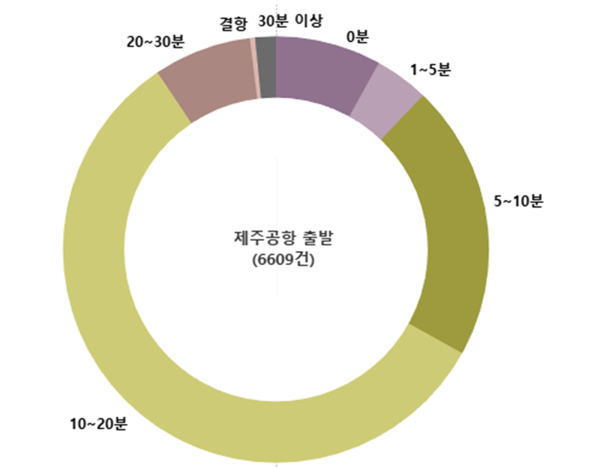
04. 현황 분석
제시간에 출발했는데, 이렇게 늦게 도착한다고? (제주출발,총 6609건 )
10~20분 늦게 도착했을 때
4
1
제시간에 도착했을 때
57.5%(3802건)
8% (530건)
20~30분 늦게 도착했을 때
5
1~5분 늦게 도착했을 때
7.4%(491건)
2
4.1%(272건)
30분 이상 늦게 도착했을 때
6
1.6%(104건)
3
5~10분 늦게 도착했을 때
21%(1384건)
결항되었을 때
6
0.4% (26건)

Slide 14
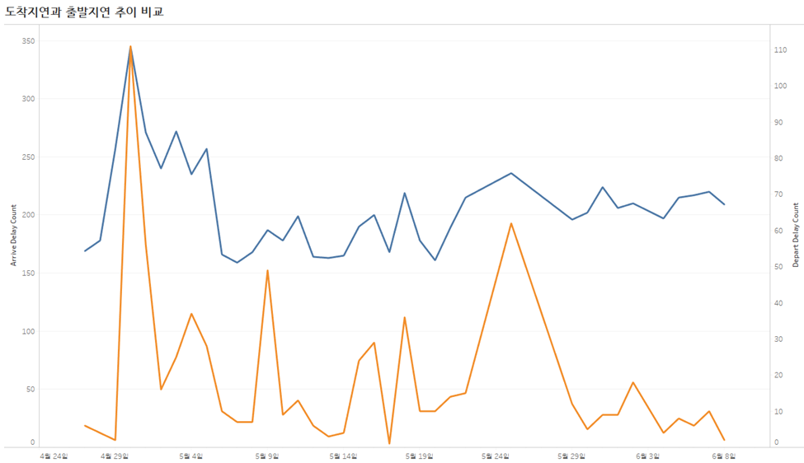
04. 현황 분석

Slide 15
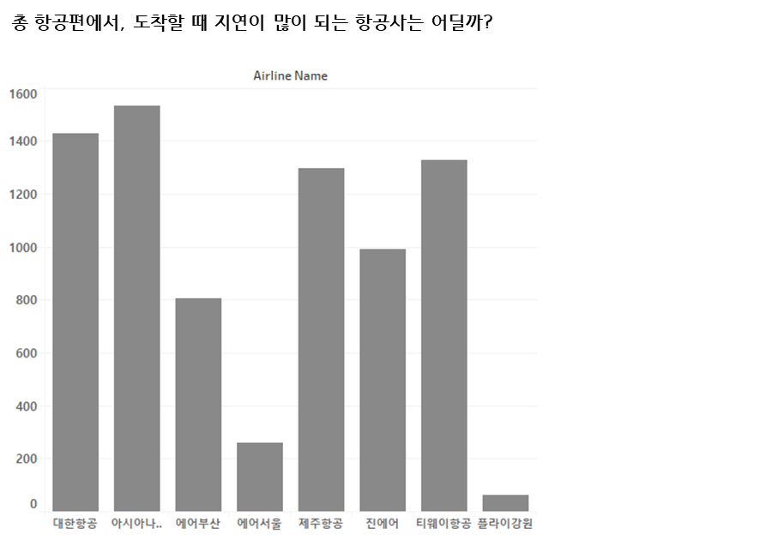
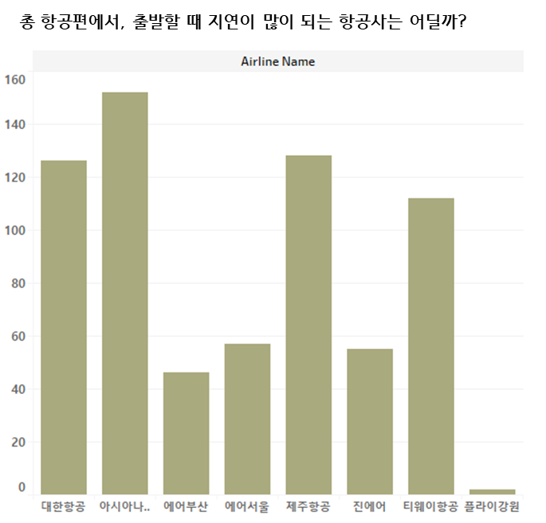
04. 현황 분석
<
678 건
7706 건

Slide 16

2
ADD YOUR TITLE
nd
ADD YOUR TITLE
ADD YOUR TITLE
ADD YOUR TITLE

Slide 17
ADD YOUR TITLE
80%
60%
50%
51%
TEXT
45%
40%
TEXT
30%
15%
YOUR TITLE
YOUR TITLE
YOUR TITLE
YOUR TITLE
Click here to enter your text messages click here to enter your text messages
Click here to enter your text messages click here to enter your text messages
Click here to enter your text messages click here to enter your text messages
Click here to enter your text messages click here to enter your text messages

Slide 18
ADD YOUR TITLE
ADD YOUR TITLE
ADD YOUR TITLE
Click here to enter your text messages click here to enter your text click here to enter your text
Click here to enter your text messages click here to enter your text click here to enter your text
ADD YOUR TITLE
ADD YOUR TITLE
Click here to enter your text messages click here to enter your text click here to enter your text
Click here to enter your text messages click here to enter your text click here to enter your text

Slide 19
ADD YOUR TITLE
YOUR TITLE
YOUR TITLE
Click here to enter your text messages click here to enter your text messages click here to enter your text messages
Click here to enter your text messages click here to enter your text messages click here to enter your text messages
01
04
03
02
YOUR TITLE
YOUR TITLE
Click here to enter your text messages click here to enter your text messages click here to enter your text messages
Click here to enter your text messages click here to enter your text messages click here to enter your text messages

Slide 20



ADD YOUR TITLE
YOUR TITLE
YOUR TITLE
Click here to enter your text messages
Click here to enter your text messages
YOUR TITLE
YOUR TITLE
YOUR TITLE
Click here to enter your text messages
Click here to enter your text messages
Click here to enter your text messages

Slide 21






ADD YOUR TITLE
YOUR TITLE HERE
Click here to enter your text messages click here to enter your text click here to enter your text
YOUR TITLE
ADD YOUR TITLE
Click here to enter your text messages click here to enter your text
YOUR TITLE
Click here to enter your text messages click here to enter your text
ADD YOUR TITLE
ADD YOUR TITLE
YOUR TITLE
Click here to enter your text messages click here to enter your text

Slide 22




ADD YOUR TITLE
01 TITLE
02 TITLE
03TITLE
04 TITLE
Click here to enter your text messages click here to enter your text
Click here to enter your text messages click here to enter your text
Click here to enter your text messages click here to enter your text
Click here to enter your text messages click here to enter your text

Slide 23

3
ADD YOUR TITLE
ADD YOUR TITLE
rd
ADD YOUR TITLE
ADD YOUR TITLE

Slide 24



ADD YOUR TITLE
ADD YOUR TITLE
Click here to enter your text messages click here to enter your text click here to enter your text click here to enter your text click here to enter your text click here to enter your text click here to enter your text
YOUR TITLE
YOUR TITLE
TITLE HERE
Click here to enter your text messages click here to enter your text messages
Click here to enter your text messages click here to enter your text messages
Click here to enter your text messages click here to enter your text click here to enter your text

Slide 25
ADD YOUR TITLE
45%
32%
68%
51%
YOUR TITLE
YOUR TITLE
Click here to enter your text messages
Click here to enter your text messages click here to enter your text messages
YOUR TITLE
YOUR TITLE
Click here to enter your text messages click here to enter your text messages
Click here to enter your text messages click here to enter your text messages

Slide 26




ADD YOUR TITLE
Click here to enter your text messages click here to enter your text
Click here to enter your text messages click here to enter your text
YOUR TITLE
Click here to enter your text messages click here to enter your text messages click here to enter your text messages click here to enter your text messages
Click here to enter your text messages click here to enter your text
Click here to enter your text messages click here to enter your text

Slide 27

4
ADD YOUR TITLE
ADD YOUR TITLE
th
ADD YOUR TITLE
ADD YOUR TITLE

Slide 28



ADD YOUR TITLE
TITLE HERE
TITLE HERE
Click here to enter your text messages click here to enter your text
Click here to enter your text messages click here to enter your text
YOUR TITLE HERE
Click here to enter your text messages click here to enter your text messages click here to enter your text messages click here to enter your text messages click here to enter your text messages click here to enter your text messages click here to enter your text messages click here to enter your text messages click here to enter your text messages click here to enter your text messages click here to enter your text messages click here to enter your text messages

Slide 29
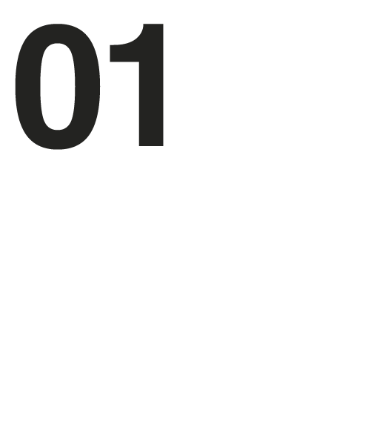



ADD YOUR TITLE
TITLE
TITLE
TITLE
TITLE
Click here to enter your text messages click here to enter your text messages
Click here to enter your text messages click here to enter your text messages
Click here to enter your text messages click here to enter your text messages
click here to enter your text messages click here to enter your text messages
Click here to enter your text messages click here to enter your text messages

Slide 30
ADD YOUR TITLE
Click here to enter your text messages click here to enter your text messages click here to enter your text messages click here to enter your text messages
Click here to enter your text messages click here to enter your text messages click here to enter your text messages click here to enter your text messages
YOUR TITLE
YOUR TITLE
Click here to enter your text messages click here to enter your text messages click here to enter your text messages click here to enter your text messages
Click here to enter your text messages click here to enter your text messages click here to enter your text messages click here to enter your text messages
YOUR TITLE
YOUR TITLE

Slide 31
ADD YOUR TITLE
YOUR TITLE
45%
Click here to enter your text messages click here to enter your text
YOUR TITLE
23%
Click here to enter your text messages click here to enter your text
YOUR TITLE
Click here to enter your text messages click here to enter your text
56%
YOUR TITLE
78%
Click here to enter your text messages click here to enter your text
YOUR TITLE
Click here to enter your text messages click here to enter your text
97%

Slide 32


THANKS
Thank you for watching , Morning for PPT

